Slide 1


Slide 2
Goals
Introduction to Data
Introduction to MySQL
RDBMS
Datatypes
Databases
Tables
SQL Queries
Join
Indexes and Stored Procedures

Slide 3
Goals
Normalization
MySQL in Cloud
MySQL Heatwave in ML

Slide 4
Introduction to Data
Data is a collection of information gathered by observations, measurements, research or analysis.
They may consist of facts, numbers, names, figures or even description of things.
Data is organized in the form of graphs, charts or tables.
There exist data scientist who does data mining and with the help of that data analyze our world.

Slide 5
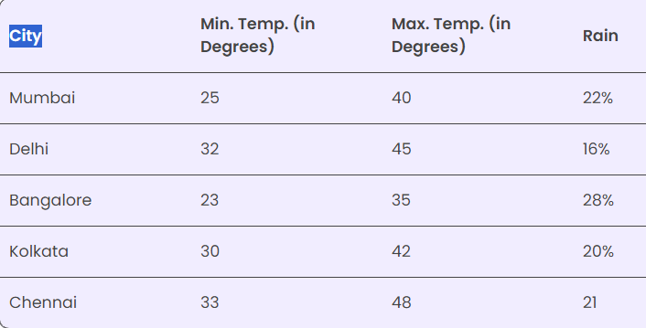
Introduction to Data

Slide 6
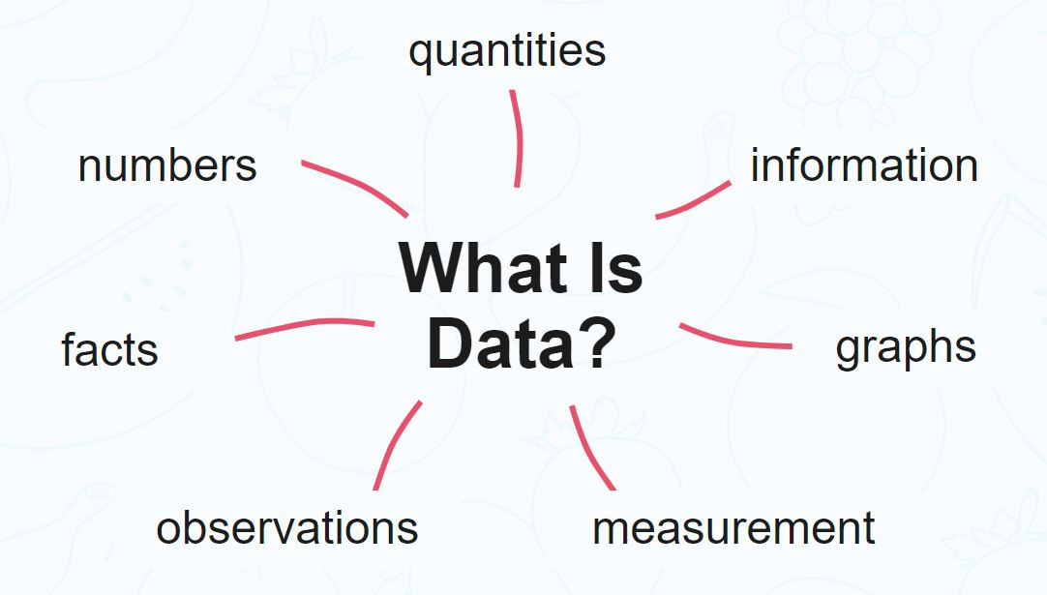
Introduction to Data
Data are units of information.
Data can be collected on any topic and for any purpose, meaning that it is used in everything from scientific research and finance to business management and retail.

Slide 7
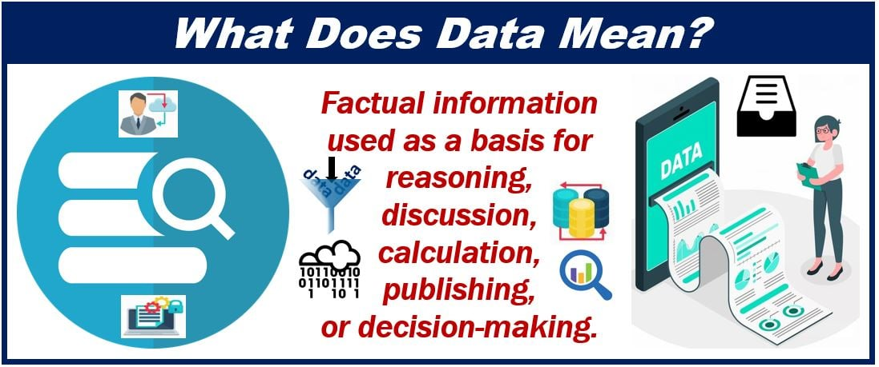
Introduction to Data

Slide 8
Data Acquisition
A data acquisition system is a system that comprises sensors, measurement devices, and a computer.
A data acquisition system is used for processing acquired data, which involves collecting the information required to understand electrical or physical phenomena.

Slide 9
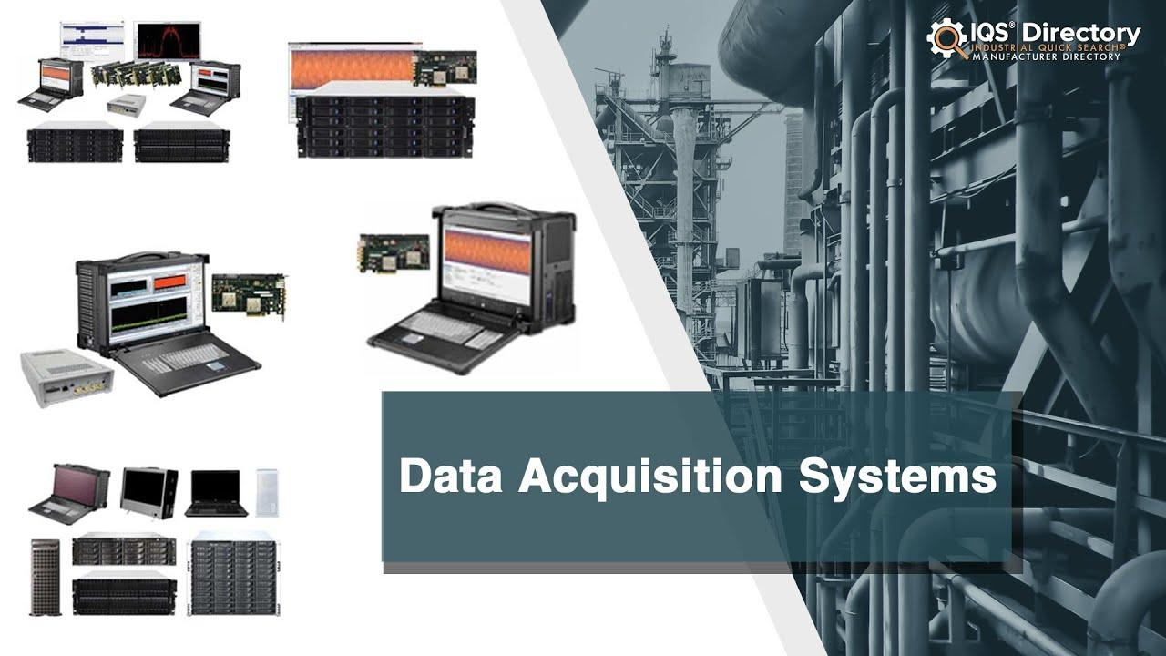
Data Acquisition

Slide 10
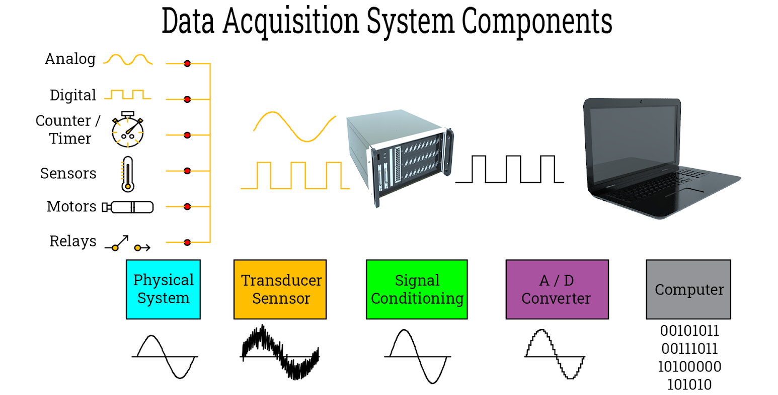
Basic Components of Data Acquisition System

Slide 11
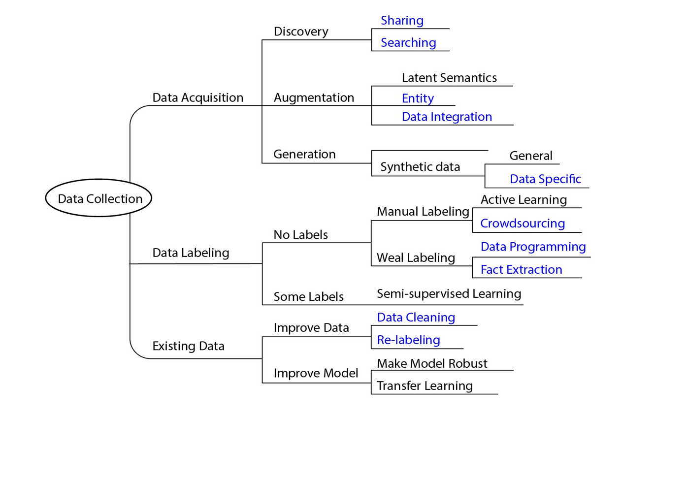
Basic Components of Data Acquisition System

Slide 12
Data Ingestion
Data ingestion is the transportation of data from assorted sources to a storage medium where it can be accessed, used, and analyzed by an organization.
The destination is typically a data warehouse, data mart, database, or a document store.
Sources may be almost anything — including SaaS data, in-house apps, databases, spreadsheets, or even information scraped from the internet.

Slide 13
Data Ingestion
In a broader sense, data ingestion can be understood as a directed dataflow between two or more systems that result in a smooth, and independent, operation (a definition which already implies some independence or automation).
Ingestion can occur in real-time, as soon as the source produces it, or in batches, when data is input in specific chunks at set periods.
Generally, three steps occur within data ingestion:
Data extraction – retrieving data from sources
Data transformation – validating, cleaning, and normalizing data to ensure accuracy and reliability (sometimes known as trustworthiness)
Data loading – routing or placing the data in its correct silo or database for analysis

Slide 14
Reasons to automate data ingestion
Automating data ingestion improves time-to-market goals.
Automating data ingestion increases scalability.
Automating data ingestion refocuses on necessary work.
Automating data ingestion mitigates risk.

Slide 15
Data Ingestion Tools
Apache NiFi (a.k.a. Hortonworks DataFlow)
Stream Sets Data Collector (SDC)
Gobblin
Sqoop
Flume
Kafka
Airflow
Spark
petl

Slide 16
Data Ingestion Tools
Panoply
Pandas
Bubbles
Bonobo
Luigi
etlalchemy

Slide 17


Slide 18
Data Types
Quantitative Data Type: –
This type of data type consists of numerical values. Anything which is measured by numbers.
ex., Profit, Quantity Sold, Height, Weight, Temperature, etc.

Slide 19
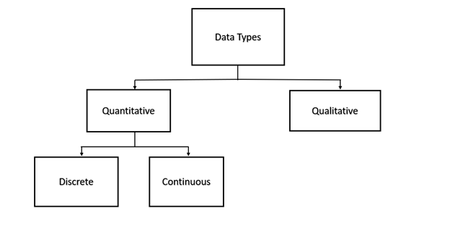
Data Types

Slide 20
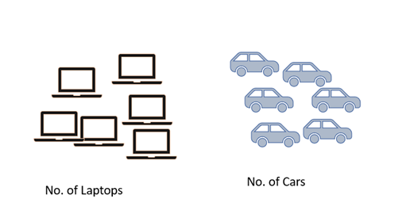
Data Types
A.) Discrete Data Type: –
The numeric data which have discrete values or whole numbers.
This type of variable value if expressed in decimal format will have no proper meaning.
Their values can be counted.
ex: – No. Of Cars You Have, No. Of Marbles In Containers, Students In A Class, etc.

Slide 21
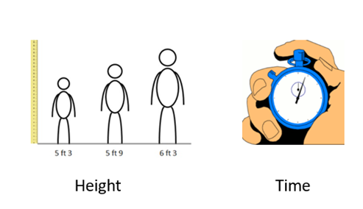
Data Types
B.) Continuous Data Type: –
The numerical measures which can take the value within A certain range.
This type of variable value if expressed in decimal format has true meaning.
Their values can not be counted but measured. The value can be infinite
ex: – Height, Weight, Time, Area, Distance, Measurement Of Rainfall, etc.

Slide 22
Data Types
Qualitative Data Type: –
These are the data types that cannot be expressed in numbers.
This describes categories or groups and is hence known as the categorical data type.

Slide 23
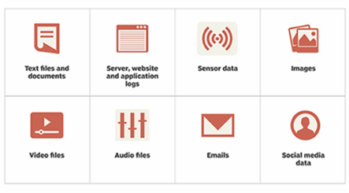
Data Types
Unstructured Data:
This type of data does not have the proper format and therefore known as unstructured data.
This comprises textual data, sounds, images, videos, etc.

Slide 24
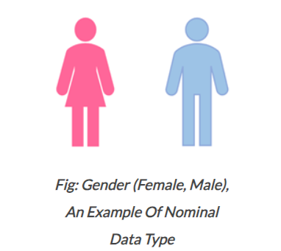
Data Types
Nominal Data Type:
This is in use to express names or labels which are not order or measurable.
ex., Male or female (gender), race, country, etc.

Slide 25
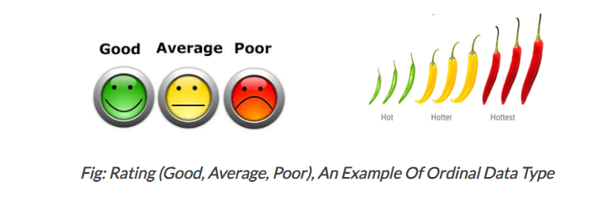
Data Types
Ordinal Data Type:
This is also A categorical data type like nominal data but has some natural ordering associated with it.
Ex., Likert rating scale, shirt sizes, ranks, grades, etc.,

Slide 26
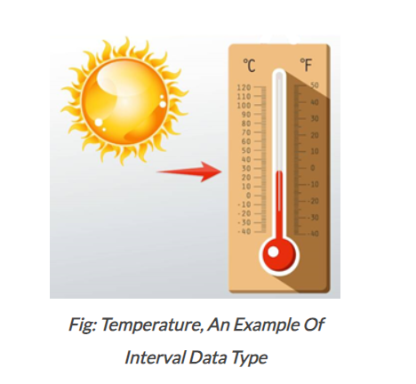
Data Types
Interval Data Type:
This is numeric data which has proper order and the exact zero means the true absence of A value attached.
Here zero means not A complete absence but has some value. This is the local scale.
ex., Temperature measured in degree Celsius, time, sat score, credit score, PH, etc. Difference between values is familiar. In this case, there is no absolute zero. Absolute

Slide 27
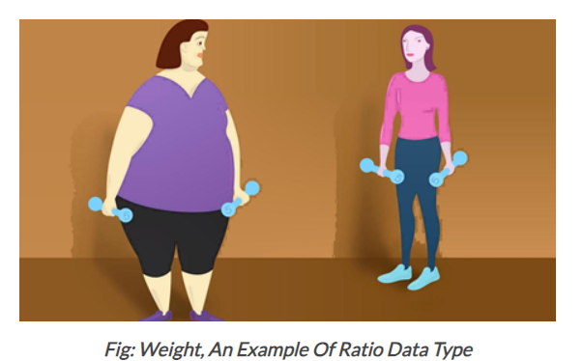
Data Types
Ratio Data Type:
This quantitative data type is the same as the interval data type but has the absolute zero. Here zero means complete absence and the scale starts from zero. This is the global scale.
ex., Temperature in kelvin, height, weight, etc.

Slide 28
Data Storage
Data storage, or data keeping, is storing information and making it as readily available as possible via technology designed particularly for that purpose.
It constitutes a simple method of storing data in digital form on computer devices, and keeping data on hand makes many digital processes more effective.
Storage devices may use electromagnetic, optical, or other media to keep the data safe and recover it when necessary.
File recovery and backup procedures become simple by data storage in the case of an unforeseen computer failure or cyberattack.

Slide 29

Data Storage

Slide 30
NAS (Network-Attached Storage)
A network-attached storage (NAS) server is a specific storage platform that links to devices over a LAN.
The server’s connectivity features allow for the retrieval and storage of data from many external devices, and NAS storage also offers extensive sharing capabilities.
The system utilizes the features of a file-storage technology and the clustering of a redundant array of drives (RAID).

Slide 31
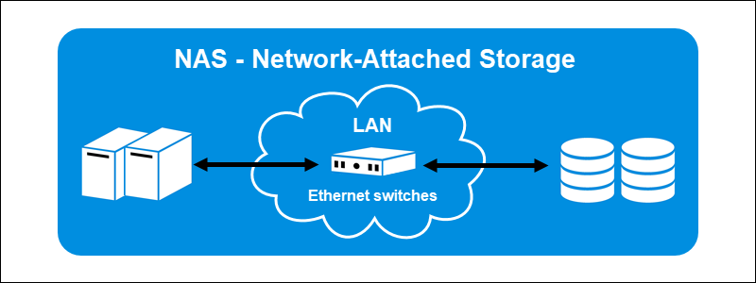
NAS (Network-Attached Storage)

Slide 32
SAN (Storage Area Network)
A storage area network (SAN) is a network-based storage that can access data at the block level.
This kind of storage consists of several data storage units connected by a network.
The storage format is an amalgam of NAS and DAS.
The storage type transfers data across a server and storage using specific networking protocols, like Fiber Channels.

Slide 33
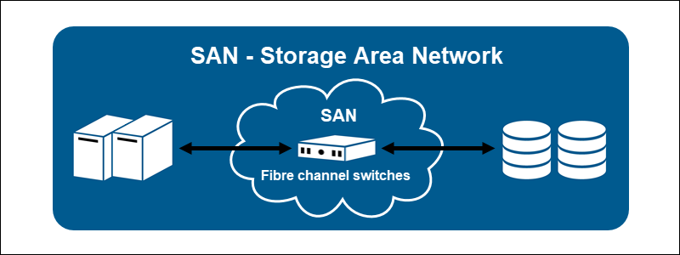
SAN (Storage Area Network)

Slide 34
Data from Various Sources
CSV file
Flat File (tab, space, or any other separator)
Text File (In a single file — reading data all at once)
ZIP file
Multiple Text Files (Data is split over multiple text files)
Download File from Internet (File hosted on a server)
Webpage (scraping)
APIs (JSON)
Text File (Reading data line by line)
RDBMS (SQL Tables)

Slide 35
B-Tree Data Structure
A B-tree is a sort of self-balancing search tree whereby each node could have more than two children and hold multiple keys.
It’s a broader version of the binary search tree. It is also usually called a height-balanced m-way tree.

Slide 36
B-Tree Data Structure
B Tree is a specialized m-way tree that can be widely used for disk access.
A B-Tree of order m can have at most m-1 keys and m children.
One of the main reason of using B tree is its capability to store large number of keys in a single node and large key values by keeping the height of the tree relatively small.

Slide 37
Need for B-Tree
The need for B-tree emerged as the demand for faster access to physical storage media such as a hard disk grew.
With a bigger capacity, backup storage devices were slower.
There was a demand for data structures that reduced the number of disc accesses.

Slide 38
Need for B-Tree
A binary search tree, an AVL tree, a red-black tree, and other data structures can only store one key in each node.
When you need to store a significant number of keys, the height of such trees grows quite vast, and the time it takes to access them grows.

Slide 39
Need for B-Tree
B-tree, on the other hand, can store multiple keys inside a single node and has several child nodes.
It considerably reduces the height, allowing for speedier disk access.

Slide 40
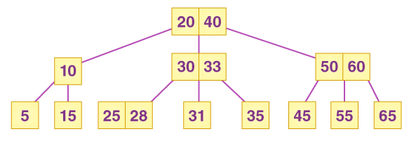
B-Tree Data Structure

Slide 41
Properties of B Tree in DBMS
A B tree of order m contains all the properties of an M way tree. In addition, it contains the following properties.
Every node in a B-Tree contains at most m children.
Every node in a B-Tree except the root node and the leaf node contain at least m/2 children.
The root nodes must have at least 2 nodes.
All leaf nodes must be at the same level.
It is not necessary that, all the nodes contain the same number of children but, each node must have m/2 number of nodes.

Slide 42
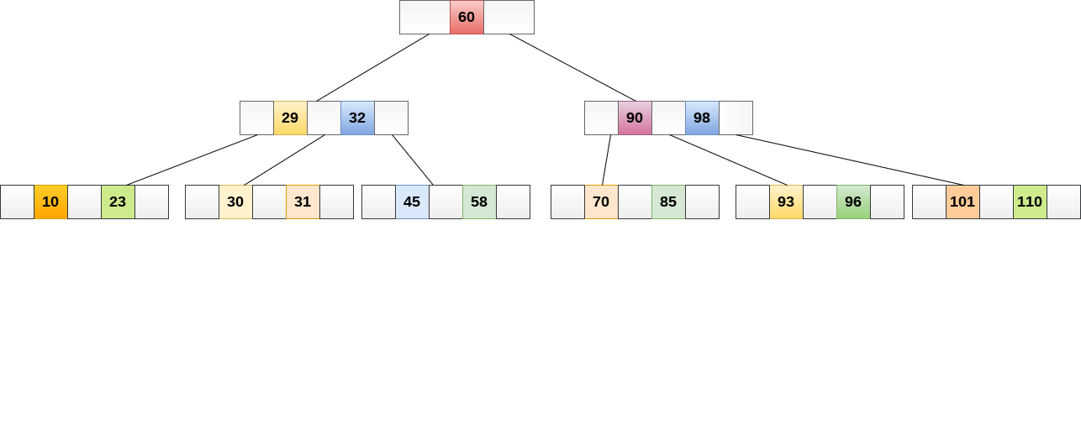
B-Tree Data Structure
A B tree of order 4 is shown in the following image.

Slide 43
Operations
Search Operation
B Trees are comparable to Binary Search Trees in terms of searching. For example, let’s look for item 49 in the B Tree below.
The procedure will go somewhat like this:
Compare item 49 to node 78, which is the root node. Move to the left sub-tree since 49 < 78.
Since 40 < 49 < 56, move to the right subtree of 40. If 49>45, move to the right, and then compare and contrast 49.
Return if a match is found.
The height of the tree affects the search in a B tree. To search an element in a B tree, the search technique requires O(log n) time.

Slide 44
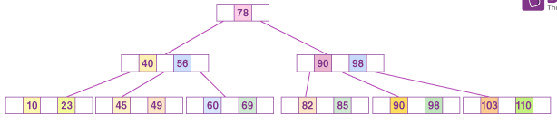
Operations

Slide 45
Operations
Insertion Operation
At the leaf node level, insertions are made. To place an item into B Tree, the following algorithm must be followed:
Navigate the B Tree until you find the suitable leaf node to insert the node at.
If there are fewer than m-1 keys in the leaf node, insert the elements in ascending order.
Otherwise, if the leaf node comprises m-1 keys, proceed to the next step.
In the rising sequence of elements, add the new element.
In the middle, divide the node into two nodes.
The median element should be pushed up to its parent node.
If the parent node has the same m-1 number of keys as the child node, split it as well using the very same steps.

Slide 46
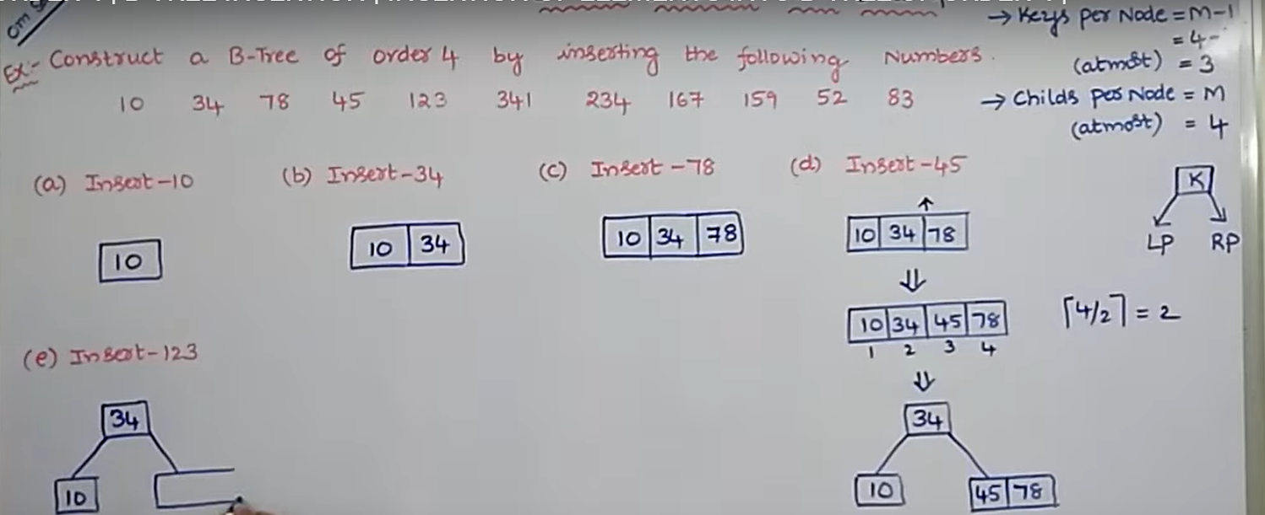
Operations

Slide 47
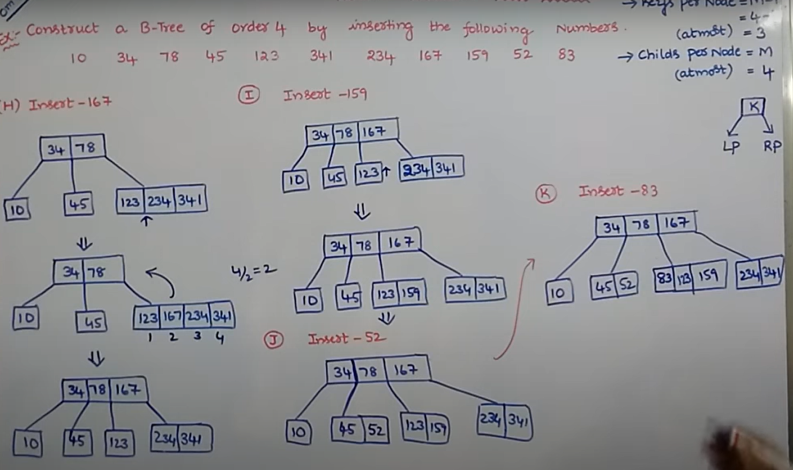
Operations

Slide 48
Difference between Structured, Semi-structured and Unstructured data
PROPERTIES | STRUCTURED DATA | SEMI-STRUCTURED DATA | UNSTRUCTURED DATA
Technology | It is based on Relational database table | It is based on XML/RDF | It is based on character and binary data
Transaction management | Matured transaction and various concurrency technique | Transaction is adapted from DBMS not matured | No transaction management and no concurrency
Version management | Versioning over tuples,row,tables | Versioning over tuples or graph is possible | Versioned as whole
Flexibility | It is sehema dependent and less flexible | It is more flexible than structuded data but less than flexible than unstructured data | it very flexible and there is abbsence of schema
Scalability | It is very difficult to scale DB schema | It’s scaling is simpler than sstructured data | It is very scalable
Robustness | Very robust | New technology, not very spread | —
Query performance | Structured query allow complex joining | Queries over anonymous nodes are possible | Only textual query are possible

Slide 49
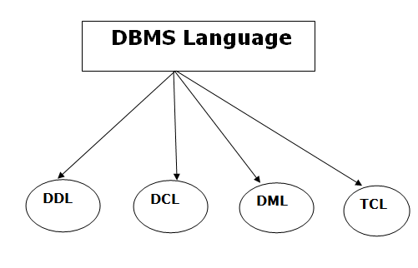
Database Languages

Slide 50
Database Languages
Data Definition Language (DDL)
DDL stands for Data Definition Language. It is used to define database structure or pattern.
It is used to create schema, tables, indexes, constraints, etc. in the database.
Using the DDL statements, you can create the skeleton of the database.
Data definition language is used to store the information of metadata like the number of tables and schemas, their names, indexes, columns in each table, constraints, etc.

Slide 51
Database Languages
Here are some tasks that come under DDL:
Create: It is used to create objects in the database.
Alter: It is used to alter the structure of the database.
Drop: It is used to delete objects from the database.
Truncate: It is used to remove all records from a table.
Rename: It is used to rename an object.
Comment: It is used to comment on the data dictionary.

Slide 52
Database Languages
Data Manipulation Language (DML)
DML stands for Data Manipulation Language. It is used for accessing and manipulating data in a database.
It handles user requests.

Slide 53
Database Languages
Select: It is used to retrieve data from a database.
Insert: It is used to insert data into a table.
Update: It is used to update existing data within a table.
Delete: It is used to delete all records from a table.
Merge: It performs UPSERT operation, i.e., insert or update operations.
Call: It is used to call a structured query language or a Java subprogram.
Explain Plan: It has the parameter of explaining data.
Lock Table: It controls concurrency.

Slide 54
Database Languages
Data Control Language (DCL)
DCL stands for Data Control Language. It is used to retrieve the stored or saved data.
The DCL execution is transactional. It also has rollback parameters.
(But in Oracle database, the execution of data control language does not have the feature of rolling back.)

Slide 55
Database Languages
Here are some tasks that come under DCL:
Grant: It is used to give user access privileges to a database.
Revoke: It is used to take back permissions from the user.
There are the following operations which have the authorization of Revoke:
CONNECT, INSERT, USAGE, EXECUTE, DELETE, UPDATE and SELECT.

Slide 56
Database Languages
Transaction Control Language (TCL)
TCL is used to run the changes made by the DML statement. TCL can be grouped into a logical transaction.
Here are some tasks that come under TCL:
Commit: It is used to save the transaction on the database.
Rollback: It is used to restore the database to original since the last Commit.

Slide 57
Procedural & Non-Procedural programming language
Procedural Language: In procedural languages, the program code is written as a sequence of instructions.
User must specify “what to do” and “how to do” (step by step procedure).
These instructions are executed in the sequential order.
These instructions are written to solve specific problems.
Examples of Procedural languages:
FORTRAN, COBOL, ALGOL, BASIC, C and Pascal.

Slide 58
Procedural & Non-Procedural programming language
Non-Procedural Language: In the non-procedural languages, the user must specify only “what to do” and not “how to do”.
It is also known as an applicative or functional language.
It involves the development of the functions from other functions to construct more complex functions.
Examples of Non-Procedural languages:
SQL, PROLOG, LISP.

Slide 59
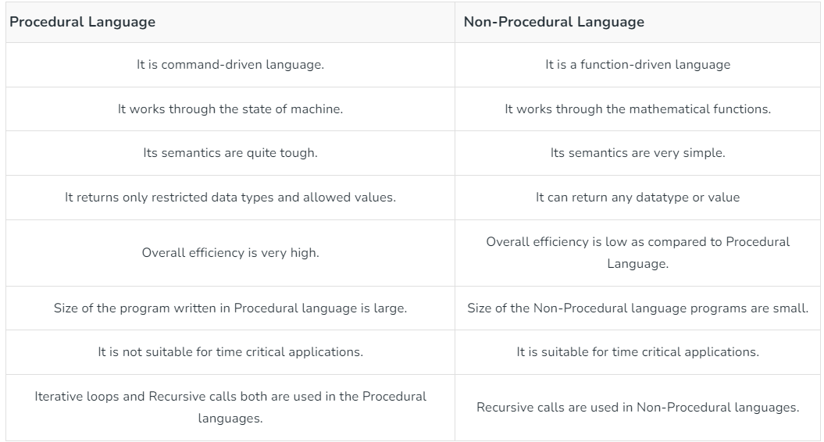
Procedural & Non-Procedural programming language

Slide 60
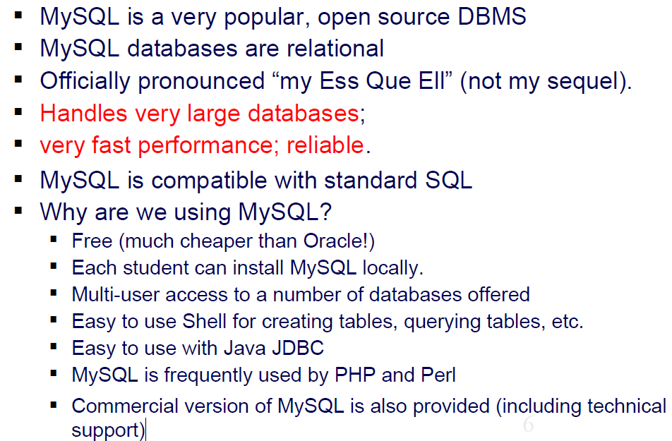
Introduction to MySQL

Slide 61
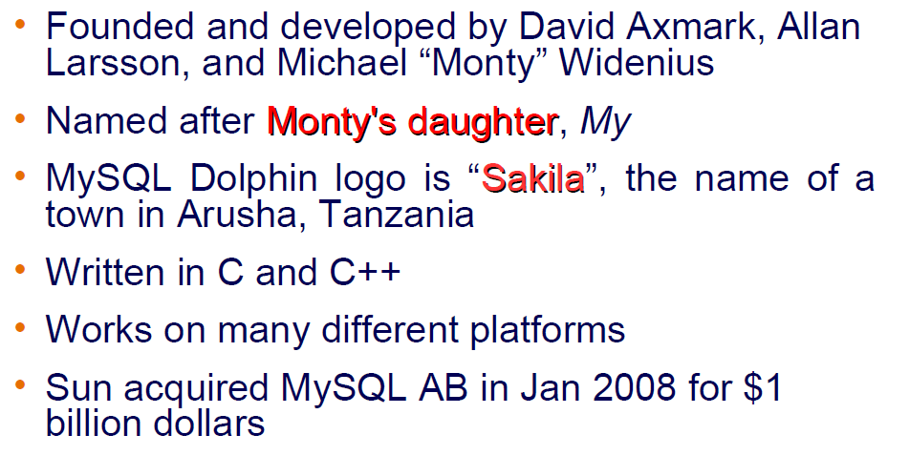
MySQL History

Slide 62
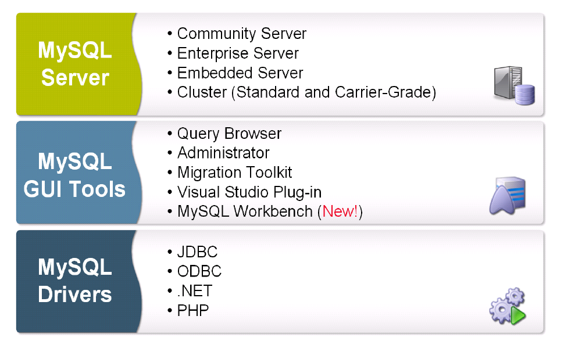
MySQL Products

Slide 63
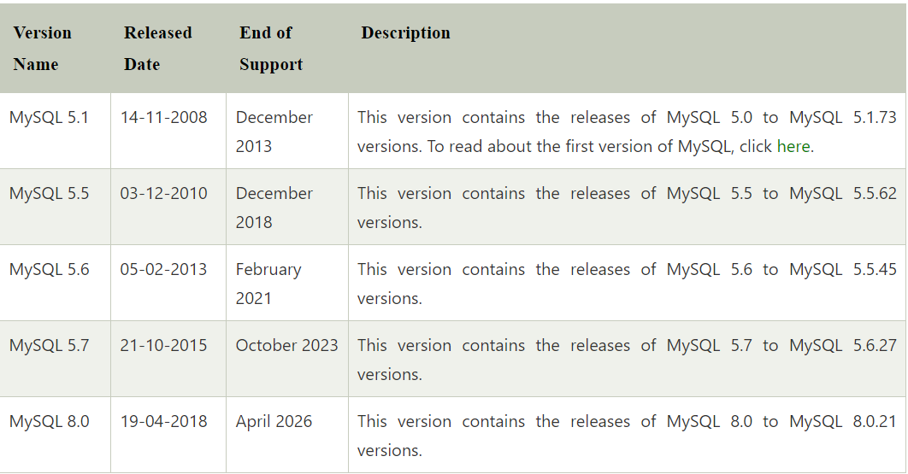
MySQL Versions

Slide 64
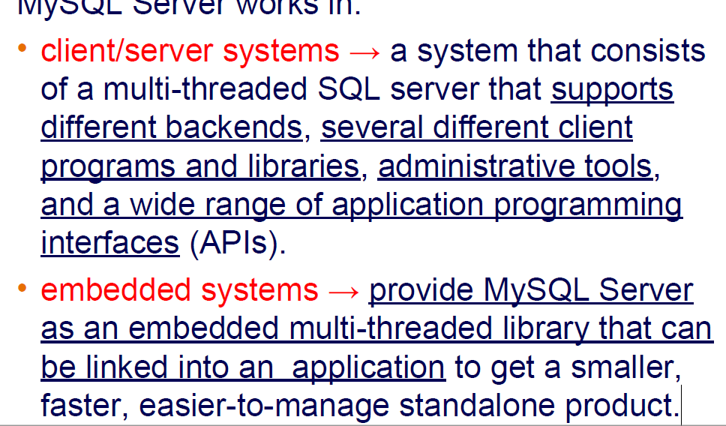
MySQL: characteristics

Slide 65
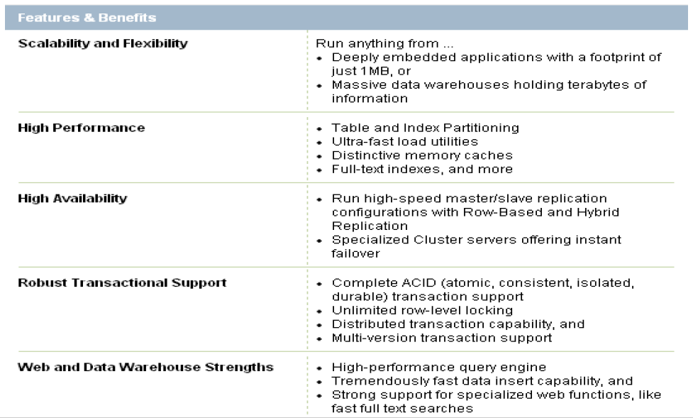
MySQL: Features and Benefits

Slide 66
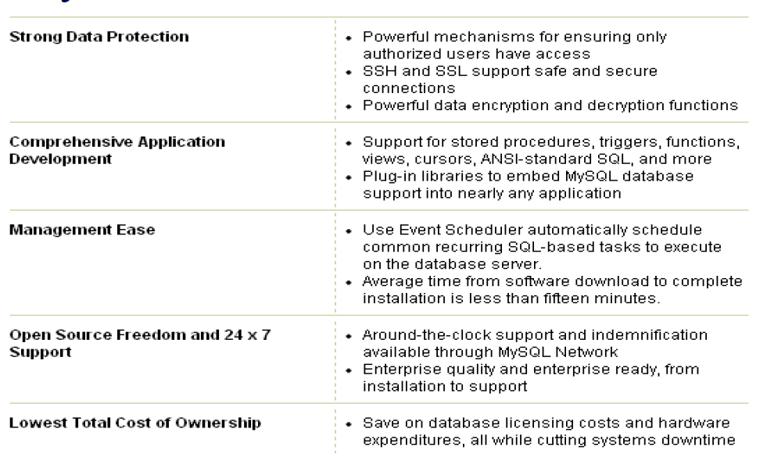
MySQL: Features and Benefits

Slide 67
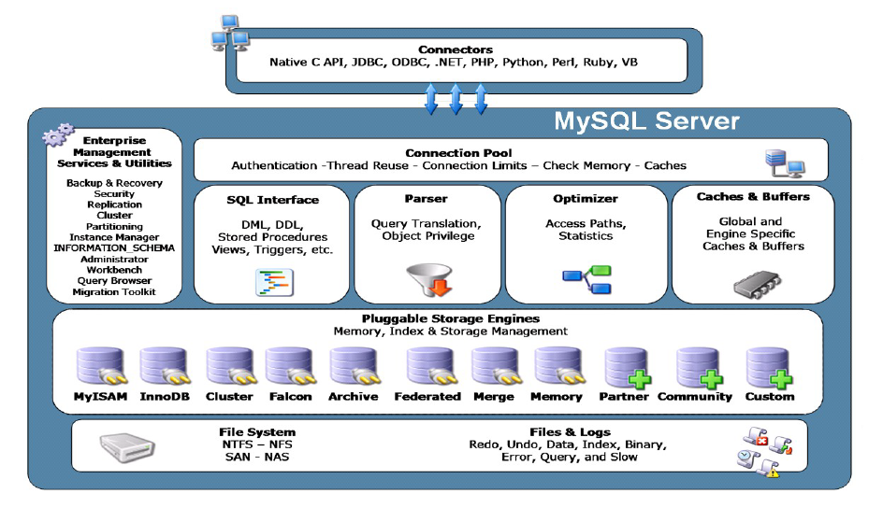
MySQL Architecture

Slide 68
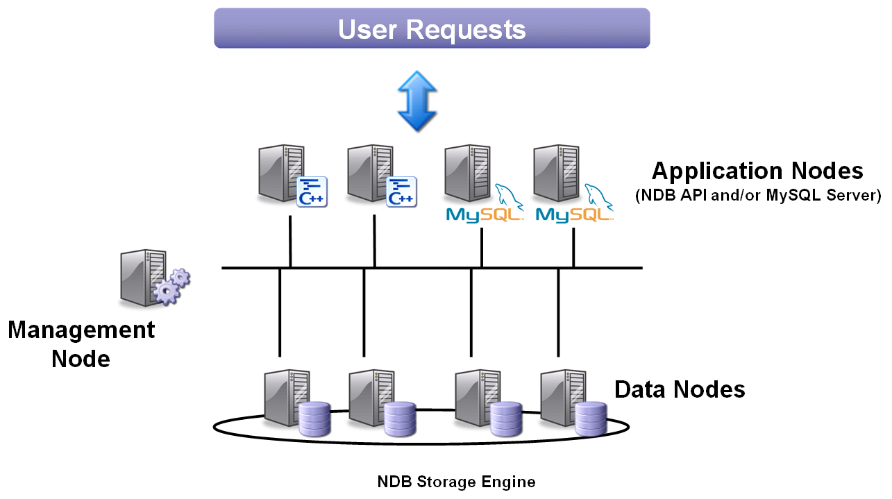
MySQL Clusters

Slide 69
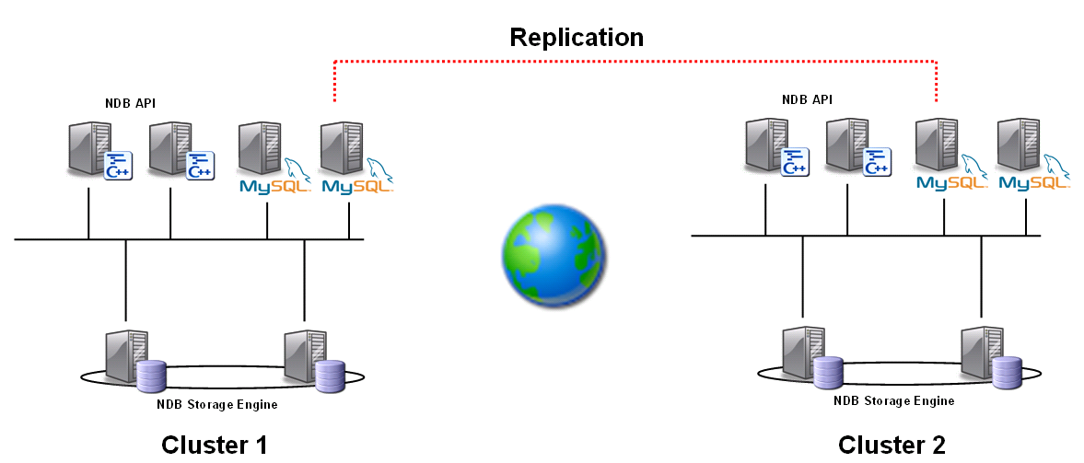
Geographic Redundancy
Asynchronous MySQL replication between clusters
Enables a higher degree of availability and continuity

Slide 70
Memcached
Developed by Danga Interactive to improve performance of LiveJournal
Distributed architecture layer that provides caching
Client/Server design
Servers are memcached daemons
Clients are implemented via language APIs like Java, PHP, C++, etc.

Slide 71
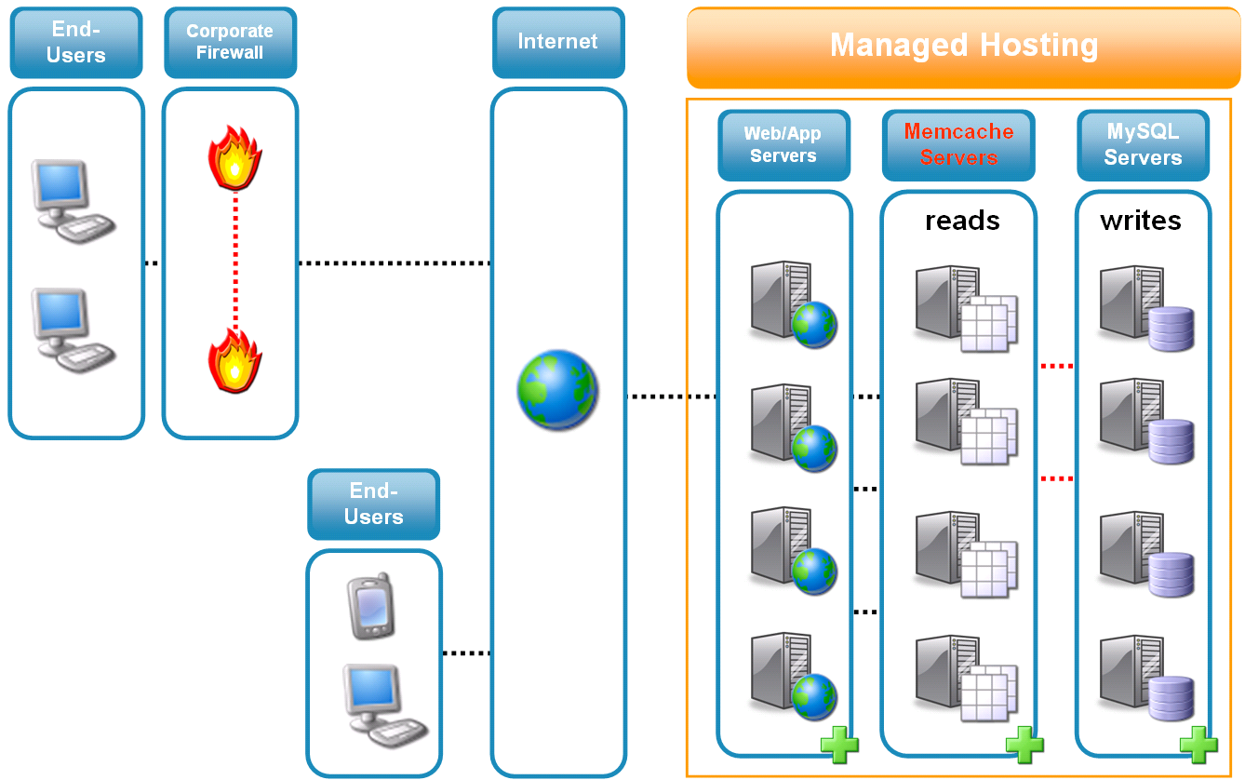
Memcached Supported with Enterprise Subscription

Slide 72
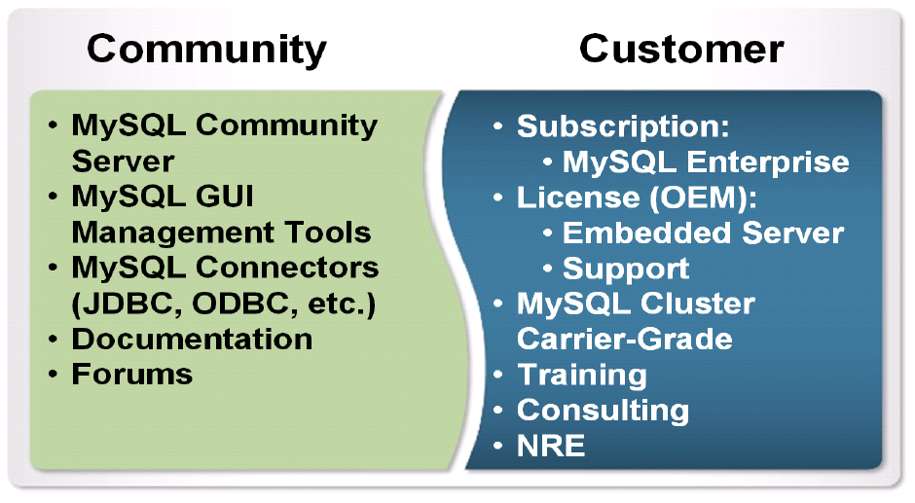
MySQL Community and Customers

Slide 73
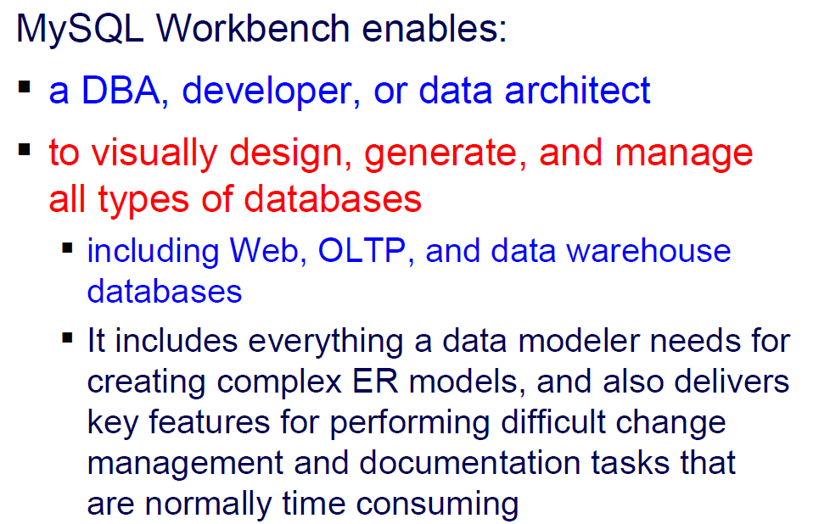
MySQL Workbench

Slide 74
How to install MySQL
Prerequisites
MySQL Setup Software
Microsoft .NET Framework 4.5.2
Microsoft Visual C++ Redistributable for Visual Studio 2019
RAM 4 GB (6 GB recommended)

Slide 75
Download MySQL
Step 1: Go to the official website of MySQL and download the community server edition software. Here, you will see the option to choose the Operating System, such as Windows.
Step 2: Next, there are two options available to download the setup.
Choose the version number for the MySQL community server, which you want.
If you have good internet connectivity, then choose the mysql-installer-web-community. Otherwise, choose the other one.

Slide 76
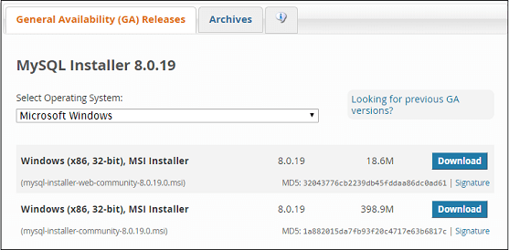
Download MySQL

Slide 77
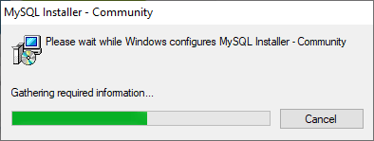
Download MySQL

Slide 78
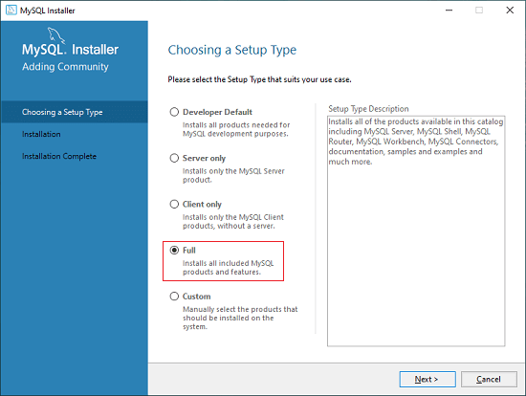
Download MySQL

Slide 79
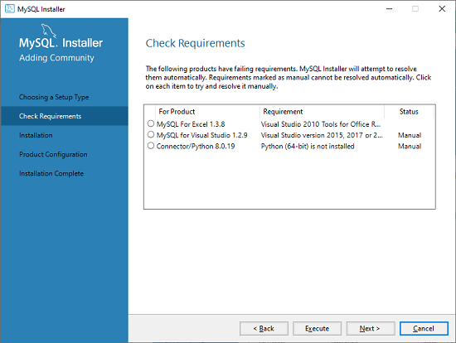
Download MySQL

Slide 80
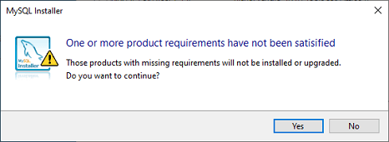
Download MySQL

Slide 81
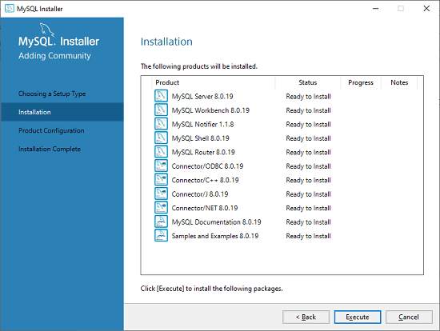
Download MySQL

Slide 82
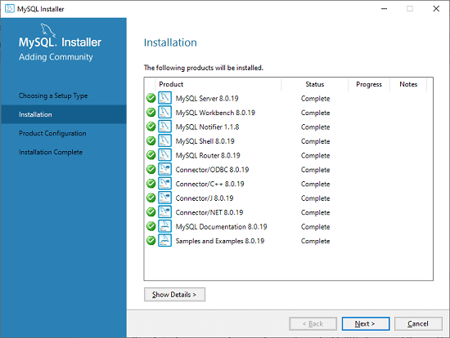
Download MySQL

Slide 83
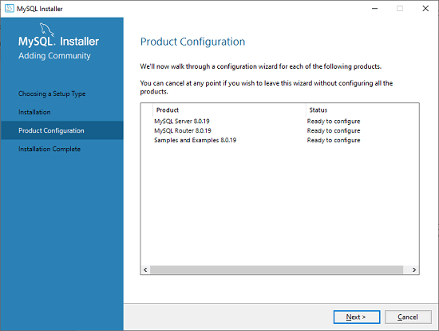
Download MySQL

Slide 84
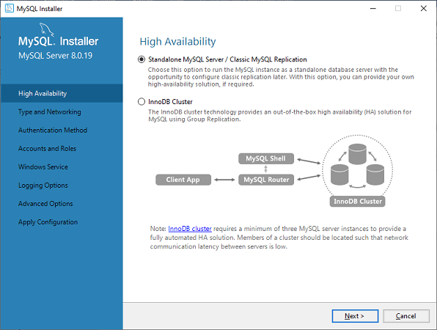
Download MySQL

Slide 85
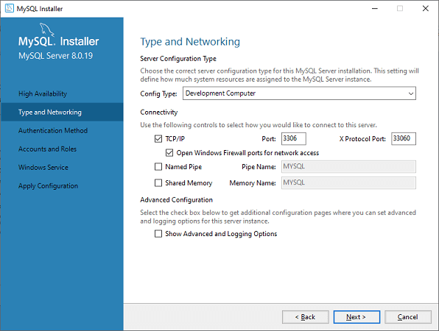
Download MySQL

Slide 86
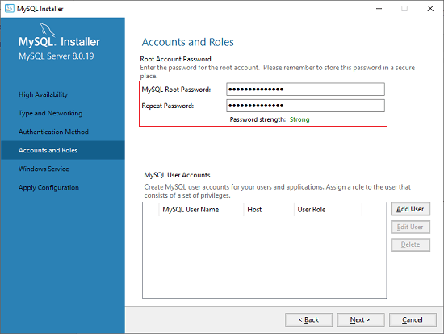
Download MySQL

Slide 87
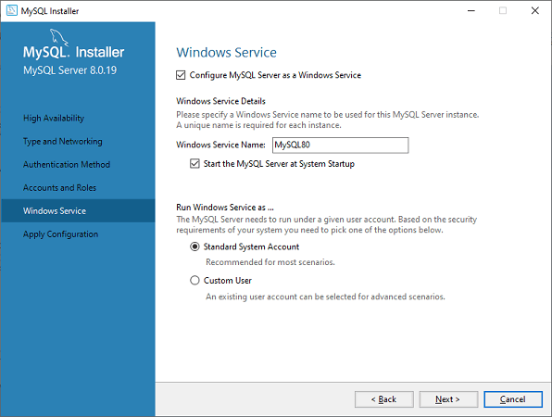
Download MySQL

Slide 88
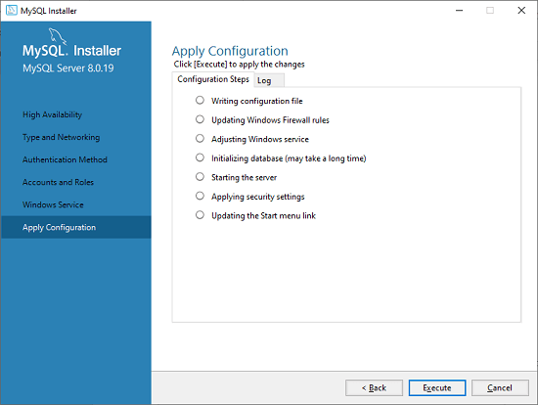
Download MySQL

Slide 89
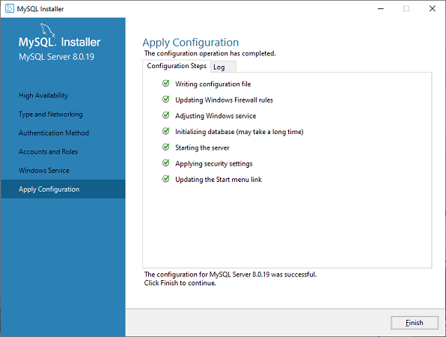
Download MySQL

Slide 90

Download MySQL

Slide 91

Download MySQL

Slide 92

Download MySQL

Slide 93

Download MySQL

Slide 94
MySQL Table Types/Storage Engines
MySQL table types/storage engines are essential features that can be used effectively for maximizing the database's performance.
It handles create, read, and update operations for storing and managing the information in a database.

Slide 95
MySQL Table Types/Storage Engines
ISAM
MyISAM
MERGE
InnoDB
MEMORY (HEAP)
ARCHIVE
BDB
CSV
FEDERATED

Slide 96

MySQL Table Types/Storage Engines

Slide 97
MySQL Table Types/Storage Engines
ISAM Table
It is abbreviated as Indexed Sequential Access Method.
This table type/storage engine has been deprecated and removed from MySQL version 5.x.
MyISAM now replaces the functionalities of this table.
The size of an ISAM table is 4 GB, which requires expensive hardware. It is not portable.

Slide 98
MySQL Table Types/Storage Engines
MyISAM Table
It is an extension of the ISAM storage engine.
The MyISAM table types are optimized for compression and speed and can be easily portable between system to system.
Before version 5.5, if we do not specify the table type during table creation, it was the default storage engine.
From version 5.x, InnoDB is used as the default table type/storage engine.
The MyISAM table size is dependent on the OS and can be up to 256 TB.
It can be compressed into read-only tables that save spaces in memory.
MyISAM table type can store 64 keys per table and contains 1024 bytes maximum key length.
The MyISAM tables work very fast, but they are not transaction-safe.

Slide 99
MySQL Table Types/Storage Engines
MyISAM Table
MyISAM tables are not transactions-safe.
It has poor data integrity and crash recovery.
When we lock the entire table, in that case, MyISAM is slower than InnoDB.

Slide 100
MySQL Table Types/Storage Engines
InnoDB Table
The InnoDB tables in MySQL fully support transaction-safe storage engine with ACID-compliant.
It is the first table type that supports foreign keys.
The InnoDB tables also provide optimal performance. Its size can be up to 64TB.
InnoDB tables are also portable between systems to systems like MyISAM.
InnoDB tables can also be checked and repairs by MySQL whenever necessary.
InnoDB tables take more space on disk in comparison with MyISAM.

Slide 101
Questions

Slide 102
Module Summary
MySQL Basic to Intermediate
MongoDB Foundation and Cloud

